Slide 1
Global Electric Vehicles Analysis using Big Data Analytics (PySpark)
Name: M.SANJANA
Roll No: 2211CS010154 (S1)
Dataset: Electric Vehicle Analysis)Dataset(Kaggle)
Email:sanjanamadishetti27@gmail.com
LinkedIn: https://www.linkedin.com/in/sanjana-madishetti-759939336Email: vattikondasreeja4@gmail.com

Slide 2
Agenda
Introduction
Initial Analysis of Dataset
Dataset Observations
Graphs
Conclusion

Slide 3
Introduction
The dataset contains information about the growth of electric vehicles (EVs) around the world. It includes details such as the number of EVs sold each year, their market share compared to traditional vehicles, the types of EVs (Battery EVs and Plug-in Hybrid EVs), and how different countries and regions are adopting them. It also provides insights into the availability of charging infrastructure and how government policies support EV adoption.
In short, this dataset helps us understand how EVs are growing globally, which regions are leading, and what factors are influencing this growth.

Slide 4
Initial Analysis of the Dataset
Dataset Size: ~130,000 vehicle records covering EV registrations up to 2023.
Key Columns:
Vehicle details: VIN, Make, Model, Model Year, EV Type (BEV/PHEV)
Performance attributes: Electric Range, Base MSRP
Policy data: CAFV Eligibility (Clean Alternative Fuel Vehicle incentives)
Geographic info: County, State, Legislative District
Missing Values: Some missing entries in Base MSRP and CAFV Eligibility. Occasional blanks in geographic fields.
Duplicates: No duplicates in analysis, since VINs are unique identifiers.
Outliers: Outliers appear in Electric Range (very low <20 miles for early PHEVs, very high >350 miles for modern BEVs). MSRP also shows extreme values for luxury EVs.

Slide 5
Initial Analysis of the Dataset
Basic Statistics:
Model Years: 1997–2023, with a sharp rise in EV registrations post-2015.
Electric Range: Wide variation, from <20 miles to >350 miles.
Dominant Brands: Tesla, Nissan, Chevrolet, Toyota, Ford.
EV Types: BEVs dominate in recent years; PHEVs more common before 2015.
Categorical Distributions:
EV Type: BEVs growing faster than PHEVs.
Geography: Registrations concentrated in California, Washington, New York.
CAFV Eligibility: Vehicles with incentive eligibility show higher adoption.

Slide 6
Dataset Observations
Total records: ~130,000 vehicle entries.
Main target variable: Electric Vehicle adoption trends (measured by registrations, type, and range).
Key factors influencing EV adoption: Model Year, EV Type (BEV/PHEV), Electric Range, and CAFV Incentive Eligibility.
Other important columns: Make, Model, Base MSRP, and Geographic Location (State/County).
Geographical data: Registrations are concentrated in states such as California, Washington, and New York, which have supportive EV policies and infrastructure.
Trends over time: Significant growth in EV adoption after 2015, with BEVs rapidly outpacing PHEVs.
No duplicate records: VINs ensure uniqueness.
Outliers: Observed in Electric Range (very low early PHEVs vs. >350-mile BEVs) and MSRP (luxury EVs vs. affordable EVs).

Slide 7
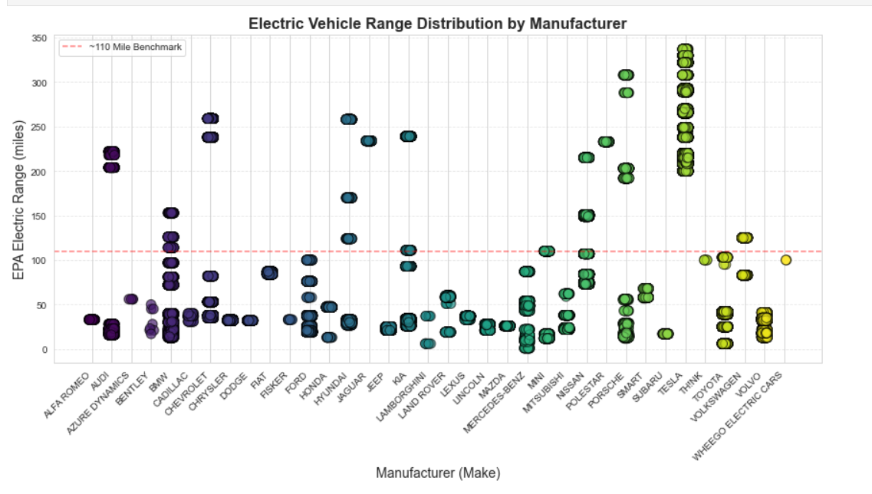
Graphs
Scatter Plot: EV Range Distribution by Manufacturer Most manufacturers have EVs below the 110-mile benchmark, but Tesla, Porsche, and Lucid consistently produce long-range vehicles above 250 miles. This shows the technological gap between premium and traditional automakers.

Slide 8
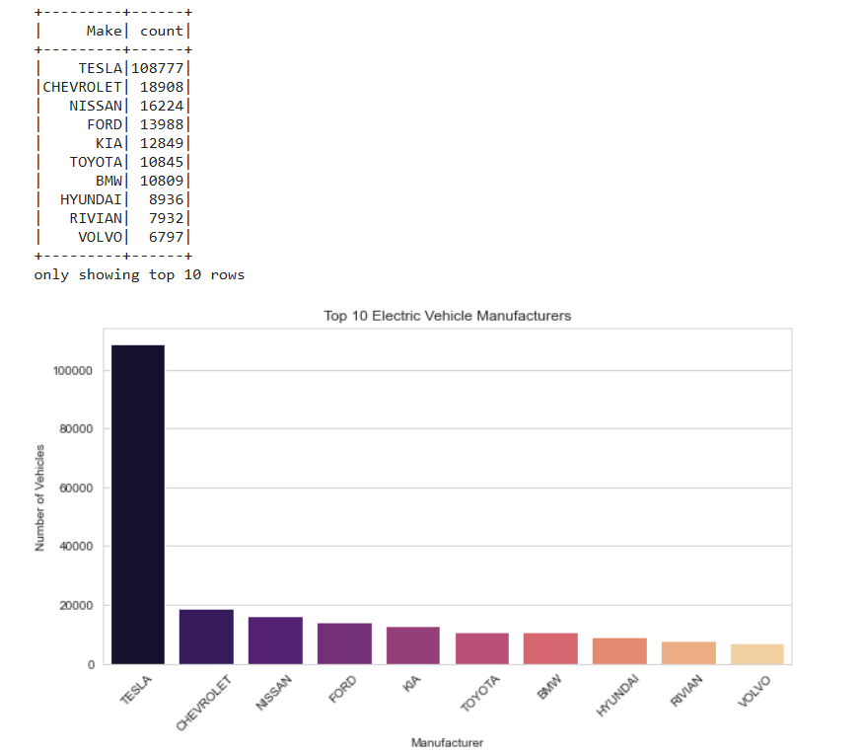
Graphs
2.Bar Chart: EVs by Manufacturer Observation: Tesla leads with the highest number of registered EVs, followed by Nissan and Chevrolet. Indicates Tesla’s dominance in the EV market.

Slide 9
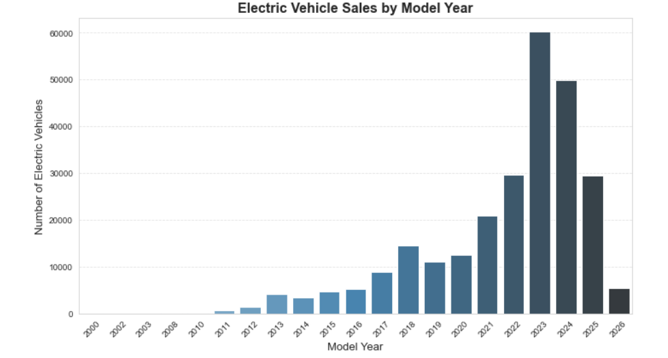
Graphs
3.Bar Chart: EV Sales by Model Year EV sales remained low until 2015 but increased rapidly afterward, with the highest registrations in 2022–2023. This trend shows accelerating adoption driven by technology improvements and policy support.

Slide 10
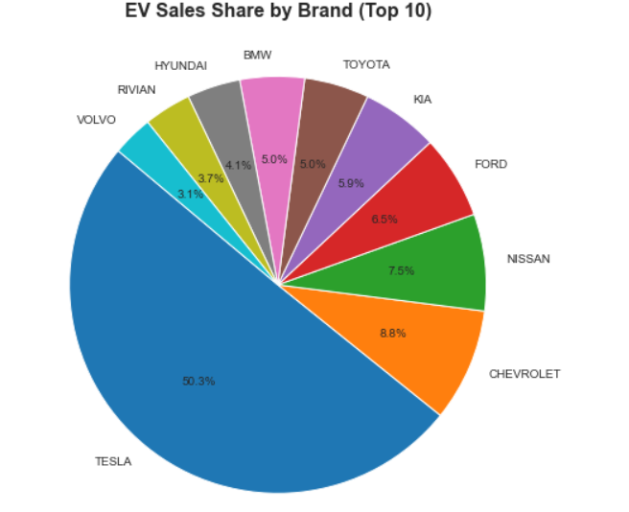
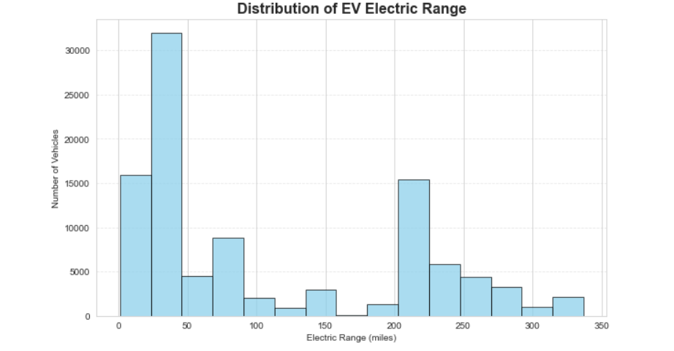
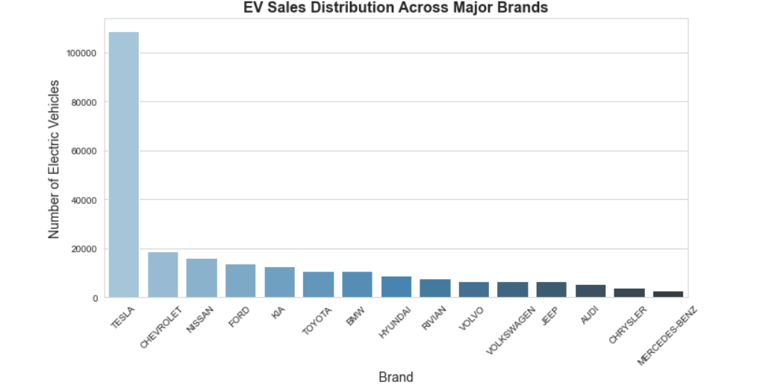

Slide 11
Conclusion
✅ Findings:
EV adoption has accelerated rapidly since 2015, led by BEVs with longer driving ranges.
Tesla dominates the market, while Nissan, Chevrolet, Toyota, and Ford play strong roles in mid-range and PHEV segments.
Government incentives (CAFV eligibility) and charging infrastructure strongly influence EV adoption.
EV registrations are highly concentrated in supportive states like California, Washington, and New York.
🎯 Future Scope:
Apply predictive models (e.g., Regression, Time-Series Forecasting) using PySpark MLlib to estimate future EV adoption.
Expand analysis with real-time EV sales, charging infrastructure, and policy datasets for global insights.
Study the link between EV adoption and carbon emission reductions to support sustainability goals.

